Slide 1
Database System
Lecture 4

Slide 2
Entity-Relationship (ER) Modeling
The ER model was created to provide a simple and understandable model for representing the structure and logic of databases.
The Entity Relational Model is a model for identifying entities to be represented in the database and representation of how those entities are related.
The ER data model specifies enterprise schema that represents the overall logical structure of a database graphically.
The Entity Relationship Diagram explains the relationship among the entities present in the database
ER models are used to model real-world objects like a person, a car, or a company and the relation between these real-world objects.
In short, the ER Diagram is the structural format of the database.

Slide 3
Why Use ER Diagrams In DBMS?
ER diagrams represent the E-R model in a database, making them easy to convert into relations (tables)
ER diagrams provide the purpose of real-world modeling of objects which makes them intently useful
ER diagrams require no technical knowledge and no hardware support
These diagrams are very easy to understand and easy to create even for a naive user.
It gives a standard solution for visualizing the data logically.

Slide 4
Symbols Used in ER Model
ER Model is used to model the logical view of the system from a data perspective which consists of these symbols:
Rectangles: Rectangles represent Entities in the ER Model.
Ellipses: Ellipses represent Attributes in the ER Model.
Diamond: Diamonds represent Relationships among Entities.
Lines: Lines represent attributes to entities and entity sets with other relationship types.
Double Ellipse: Double Ellipses represent Multi-Valued Attributes.
Double Rectangle: Double Rectangle represents a Weak Entity.

Slide 5
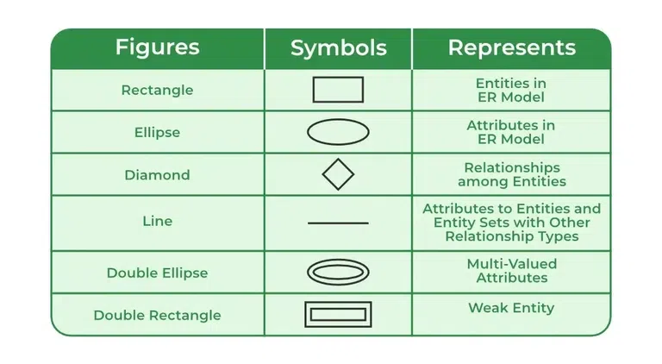

Slide 6
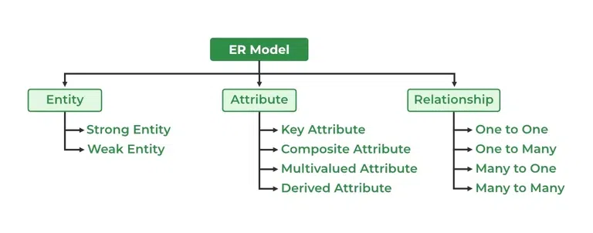
Components of ER Diagram
ER Model consists of Entities, Attributes, and Relationships among Entities in a Database System.

Slide 7
What is Entity?
An Entity may be an object with a physical existence – a particular person, car, house, or employee – or it may be an object with a conceptual existence – a company, a job, or a university course.

Slide 8
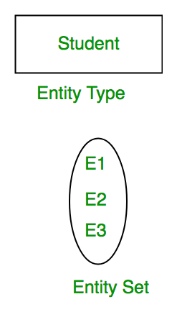
What is Entity Set?
An Entity is an object of Entity Type and a set of all entities is called an entity set. For Example, E1 is an entity having Entity Type Student and the set of all students is called Entity Set. In ER diagram, Entity Type is represented as:

Slide 9
Types of Entity
There are two types of entity:
Strong Entity: A Strong Entity is a type of entity that has a key Attribute. Strong Entity does not depend on other Entity in the Schema. It has a primary key, that helps in identifying it uniquely, and it is represented by a rectangle. These are called Strong Entity Types.
Weak Entity: An Entity type has a key attribute that uniquely identifies each entity in the entity set. But some entity type exists for which key attributes can’t be defined.

Slide 10
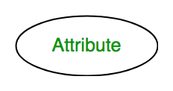
What is Attributes?
Attributes are the properties that define the entity type. For example, Roll_No, Name, DOB, Age, Address, and Mobile_No are the attributes that define entity type Student. In ER diagram, the attribute is represented by an oval

Slide 11
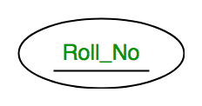
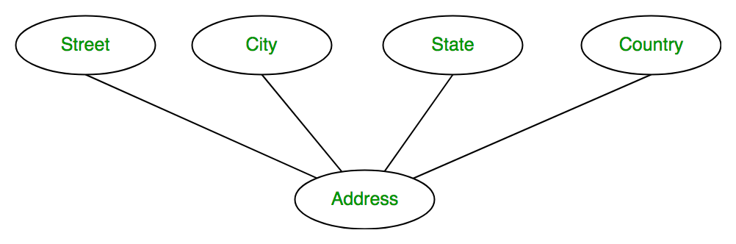
Types of Attributes
Key Attributes: The attribute which uniquely identifies each entity in the entity set is called the key attribute. For example, Roll_No will be unique for each student. In ER diagram, the key attribute is represented by an oval with underlying lines.
Composite Attribute: An attribute composed of many other attributes is called a composite attribute. For example, the Address attribute of the student Entity type consists of Street, City, State, and Country. In ER diagram, the composite attribute is represented by an oval comprising of ovals.

Slide 12
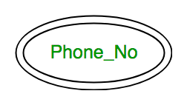
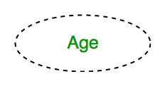
Types of Attributes(cont.)
Multivalued Attribute: An attribute consisting of more than one value for a given entity. For example, Phone_No (can be more than one for a given student). In ER diagram, a multivalued attribute is represented by a double oval.
Derived Attribute: An attribute that can be derived from other attributes of the entity type is known as a derived attribute. e.g.; Age (can be derived from DOB). In ER diagram, the derived attribute is represented by a dashed oval

Slide 13
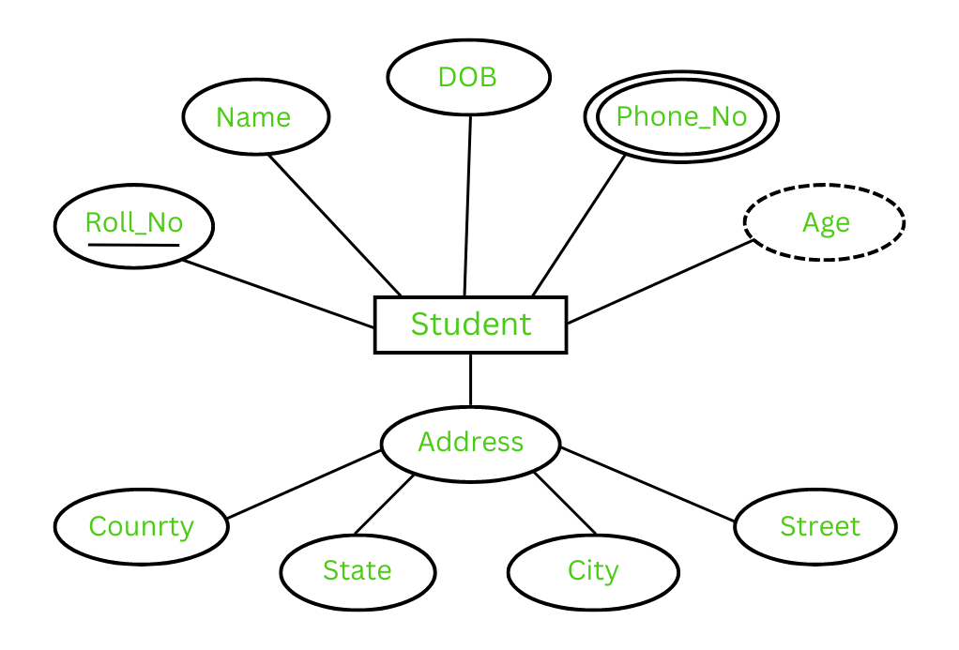
The Complete Entity Type Student with its Attributes can be represented as:

Slide 14
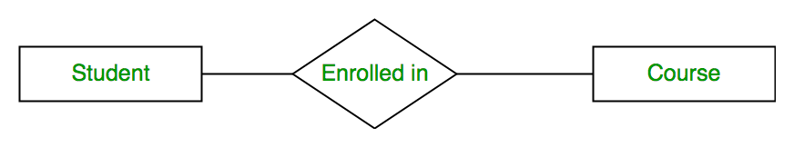
Relationship Type and Relationship Set
A Relationship Type represents the association between entity types. For example, ‘Enrolled in’ is a relationship type that exists between entity type Student and Course. In ER diagram, the relationship type is represented by a diamond and connecting the entities with lines.

Slide 15
What is Cardinality?
The number of times an entity of an entity set participates in a relationship set is known as cardinality . Cardinality can be of different types:
One-to-One: When each entity in each entity set can take part only once in the relationship, the cardinality is one-to-one.
One-to-Many: In one-to-many mapping as well where each entity can be related to more than one entity and the total number of tables that can be used in this is 2.
Many-to-One: When entities in one entity set can take part only once in the relationship set and entities in other entity sets can take part more than once in the relationship set, cardinality is many to one.
Many-to-Many: When entities in all entity sets can take part more than once in the relationship cardinality is many to many.

